Slide 1
UNIT 4. OBJECT RELATIONAL DATABASES

Slide 2
OBJECT RELATIONAL DATABASES (ORDBMS).
An object-relational database (ORD) is a database management system (DBMS) that's composed of:
a relational database (RDBMS) and
an object-oriented database (OODBMS).
ORD supports the basic components of any object-oriented database model in its schemas and the query language used, such as objects, classes and inheritance.

Slide 3
ORD
In ORD, the basic approach is based on Relational DB, since the data is stored in a traditional database and uses a query language like SQL. However, ORD also has object-oriented characteristics: the database is considered an object store, usually for software that is written in an object-oriented programming language. Here, APIs are used to store and access the data as objects.
Traditional RDBMS products concentrate on the efficient organization of data with a limited set of data-types. On the other hand, an ORDBMS has a feature that allows developers to build and innovate their own data types and methods, which can be applied to the DBMS. With this, ORDBMS allow developers to increase the abstraction with which they view the problem area.

Slide 4
Advantages: compatible with relational DBs.
Users are familiar with relational systems.
The difference with RDBs is that we have the datatype OBJECT.
OBJECTS represent an entity and has the elements:
Name: it identifies the type of object
Attributes: they define the properties of the object
Methods: define the behaviour of the object. They are procedures and functions written in a language supported by the ORDB (in case of Oracle, we can use PL/SQL or Java)

Slide 5
ORACLE: ANSI SQL 1999. EXAMPLES
CREATE TYPE person AS OBJECT(
name VARCHAR2(30),
phone VARCHAR2(20)
);
CREATE TYPE student AS OBJECT(
id_student VARCHAR2(9),
personal_data person
);
CREATE TABLE contacts OF PERSON;
INSERT INTO contacts VALUES('Pepe López','967111111');

Slide 6
ORACLE: ANSI SQL 1999. EXAMPLES
CREATE TABLE admitted (day DATE, only_studies student);
INSERT INTO admitted
VALUES('12/09/2018',student('01A', person('Pepe López','967111111')));
INSERT INTO admitted
VALUES('12/09/2018',student('02B', person('Ana Garcia','967222222')));

Slide 7
ORACLE: ANSI SQL 1999. EXAMPLES
INSERT INTO admitted
VALUES('12/09/2018',student('02B', person('Ana Garcia','967222222')));
SELECT a.only_studies.id_student,a.only_studies.personal_data.name
FROM admitted a;
SELECT a.only_studies.id_student,a.only_studies.personal_data.phone
FROM admitted a
WHERE a.only_studies.personal_data.name='Pepe López';

Slide 8
Oracle connection
We can connect to Oracle using methods as JDBC.
https://docs.oracle.com/cd/E11882_01/appdev.112/e12137/getconn.htm#TDPJD146
import java.sql.*;
public class PruebaAccesoOracle {
public static void main(String[] args) {
try{
Class.forName("oracle.jdbc.driver.OracleDriver");
Connection con = DriverManager.getConnection ("jdbc:oracle:thin:@localhost:1521:XE","system","Patata1234");
System.out.println(“Connected OK");
con.close();
}catch(Exception e){
e.printStackTrace();
}}}

Slide 9
STRUCT VS OBJECT
For the complex types, we use STRUCT:
http://www.v-espino.com/~chema/daw1/tutoriales/oracle/objetos.htm
while (rset.next()){ // Obtengo el campo nombre String nombre=rset.getString(1); // Obtengo el objeto rectangulo oracle.sql.STRUCT objeto = (oracle.sql.STRUCT) rset.getObject(2); // Saco sus atributos Object[] atributos = objeto.getAttributes(); java.math.BigDecimal alto = (java.math.BigDecimal) atributos[0]; java.math.BigDecimal ancho = (java.math.BigDecimal) atributos[1]; // ¿Y para acceder a la function -método- dime_area()? // Esto no se hacerlo // Imprimo la fila completa System.out.println("Nombre: "+nombre+ ". Dimensiones: "+alto+" x "+ancho);

Slide 10
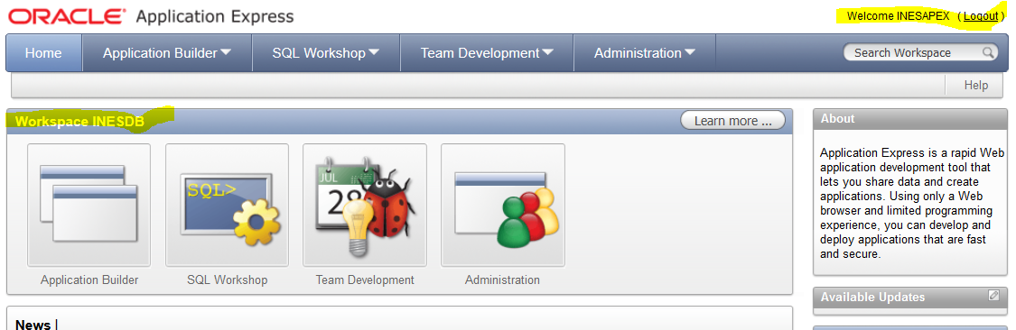
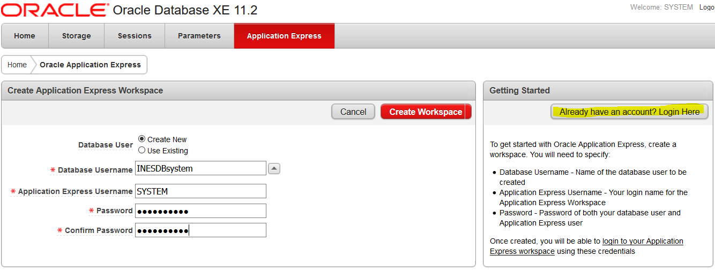
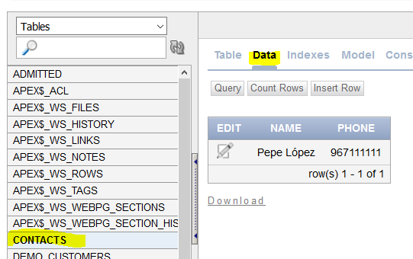
Practice 4.1. installing and using Oracle Express

